Slide 1
Baze de date NoSQL
11

Slide 2








Slide 3
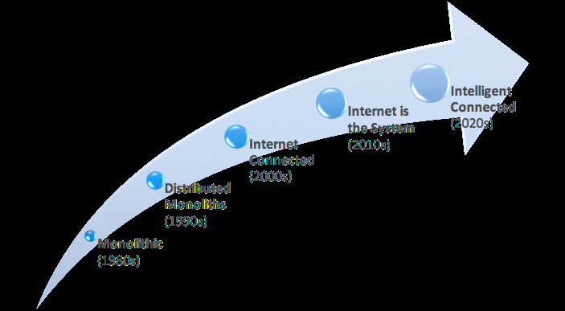
Context
Modelul relațional are aproape 50 de ani
ACID – asigură robustețea procesărilor tranzacționale dar cu costuri de performanță
Notes:
Scalabilitate verticala: utilizarea mai multor procesoare pentru a executa diverse procese ce utilizeaza aceeasi memorie interna cat si memorie externa
Scalabilitate orizontala: abilitatea de a distribui atat datele cat si executia de operatii simple pe mai multe servere fara a avea memorie interna si disc extern partajat intre servere

Slide 4
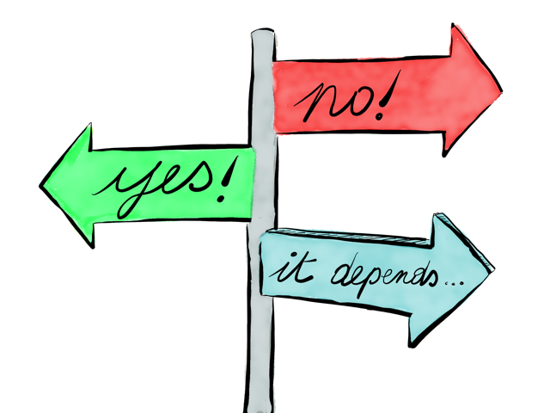
Context
Trăsăturile cele mai căutate pentru o bază de date:
Scalabilitate (verticală/orizontală)
Disponibilitate (”five nines” availability)
Performanță
Notes:
Scalabilitate verticala: utilizarea mai multor procesoare pentru a executa diverse procese ce utilizeaza aceeasi memorie interna cat si memorie externa
Scalabilitate orizontala: abilitatea de a distribui atat datele cat si executia de operatii simple pe mai multe servere fara a avea memorie interna si disc extern partajat intre servere
When examining the context in which database professionals work these days,
we can perhaps get a better understanding ofwhy the new tools might excel; in short, the task often now before them is to quickly find relevant data from terabytes of unstructured web content which may be stored across many widely dispersed nodes. Relational databases, with their large processing overhead in terms of maintaining the ACID attributes of the data they store, and their reliance on potentially processor hungry joins, are not the right tool for these needs

Slide 5
Ce înseamnă NoSQL?
Orice bază de date ce nu folosește SQL
totuși, nu include bazele de date orientate-obiect
Not Only SQL
Cassandra: limbaj de interogare java-like, CQL
O bază de date ce:
NU folosește conceptele modelului relațional pentru stocarea datelor
NU permite accesarea datelor prin intermediul limbajului SQL standard

Slide 6

Ce înseamnă NoSQL?
Exemple de baze de date NoSQL (peste 225):
https://hostingdata.co.uk/nosql-database/
“Următoarea generație de baze de date acoperă, în general, următoarele aspecte: modelare non-relațională, distribuit, open-source, scalabilitate orizontală”
Notes:
Prin exemple

Slide 7
Diferențe majore de abordare
BD Relaționale:
informațiile sunt extrase folosind operații de join,
accelerarea procesării presupune deseori indexare,
proprietățile ACID sunt impuse
Alternativă: Teorema CAP
Consistency (nu dpdv al respectării constrângerilor de integritate, ci din punct de vedere al al furnizării acelorași date tuturor clienților)
Availability – nivelul de disponibilitate crește odată cu creșterea numărului de noduri redundante
Partition Tolerance – găsirea de rute alternative în rețea pentru a obține date din diverse noduri
Notes:
The consistent as used in the ACID test means that the data that is stored in the database has all rules or constraints applied to it. In other words, the data complies with all the business rules designed into the database. The consistent as used in the CAP theorem means that all the data accessible by clients, across all nodes, is the same. As we will see below, this is not always the case in NoSQL databases. Often these databases do not have schemas and whatever data validation rules there are have to be implemented at the client end.
The other two terms in CAP Theorem are more straight-forward:
Availability refers to the ability of the database to serve data to clients. In general, the more redundant nodes a database has, the more available it will be since anyone trying to gather data from a node which is “down” can get the data from other nodes. The downside is that performance can suffer.
Partition Tolerance refers to the ability of the database to find alternate routes through the network to get at data from various nodes should there be breaks in communications. As Gilbert and Lynch (2002) suggest tolerance means: No set of failures less than total network failure is allowed to cause the system to respond incorrectly.
However, as we have seen, this sort of atomicity comes at a cost in terms of resource usage and performance. There may be circumstances where the transactional security needed by banks, or shops, is not needed. Take for example, an online Discussion Board application. Just to keep the example simple we look at a two node system. Julia goes on to the discussion board and asks a question, Question J. She is
logged on through Network 1 (though of course she isn’t aware of that). Question J gets replicated to Network 2. Users K, L, M write answers to network 1 over the next few minutes. But only K and L get replicated since the connection between the two networks breaks at the time that M is writing a response. Now hundreds of other users of the Discussion Board log on, some through Network 1 and some through Network 2. Those using the latter will not see Answer M. But does it really matter? When you first think about this you might well say
“ofcourse it matters!”. But just think about the users who logged on to Network 1 the second before M sent their answer. They were seeing exactly what users of Network 2 are seeing now. And it could well be that Answer K was the most helpful one, so they are not really any worse off because of it. If you are still not convinced, ask yourself another question—if you want to know
every user will be guaranteed access to exactly the same data, are you willing to pay for the service? Naturally such a consistent database is achievable, but it may well mean that you need to purchase an ACID compliant RDBMS, as opposed to using an open source NoSQL solution. And even if that is your preferred solution, you will then need to be prepared to see a fall in performance since no-one will be able to see Answer M until the partition is removed. As we see in the next section there are various consistency approaches available, depending upon the application’s requirements. Many of the mechanisms used in a RDBMS to ensure there is only ever one valid value stored involve preventing users seeing data by locking rows whilst transactions are under way. For the locked-out user this seems like the database is performing poorly, or worse, is not functioning properly. That user might prefer to see stale data, rather than have to wait, potentially hours, for “actual” data. For the reader interested in proof, Brewer’s CAP theorem is proved in the Gilbert
and Lynch (2002) paper; Brewer’s Conjecture and the Feasibility of Consistent, Available, Partition-Tolerant Web Services.

Slide 8
Modelul de consistență BASE
Basic Availability
Baza de date (pare că) funcționează în marea majoritate a timpului
Soft-state
Consistența la scriere nu e necesară. Replicile nu trebuie să fie mutual consistente
Eventual consistent
Baza de date va fi consistentă la un moment dat
Read Repair – Delayed Repair
Notes:
we move from a world of certainty in terms of data consistency, to a world where all we are promised is that all copies of the data will, at some point, be the same
All NoSQL Databases have different approaches to data storage because they aim to meet different needs, but they share the notion that traditional RDBMS rules and practices are not necessarily always the most appropriate.
Read Repair: When a read operation happens and discovers that some data on a node is stale (that is, it has an earlier time-stamp than that on the other nodes), the outdated data is refreshed.
Delayed Repair: The application will return the value it finds, even though it may be stale, but marks it as needing updating. The timing of that update is in the hands of the controlling, or master database. This is known as weak consistency. It is a performance oriented approach.

Slide 9
Abordări bazate pe coloane
BD Relaționale sunt abordări bazate pe linii
Foarte frecvent însă aplicațiile ce accesează o bază de date interoghează date memorate pe o coloană
În ciuda optimizărilor memorarea într-o zonă continuă a valorilor aceleași coloane e mai performantă
Notes:
There are many relational databases which have optimisation techniques that
make this problem seem trivial. And yet, the question remains; if we are retrieving data from columns more frequently than looking at several attributes from a row of data, why don’t we store the data in columns instead of rows? And that is exactly what the column-based approach provides us. The data items
for each attribute are stored one after another. The read process is thus made very simple and there are only start-toread and end-reading pointers to worry about and no jumping around to different disk segments to jump over unwanted data

Slide 10
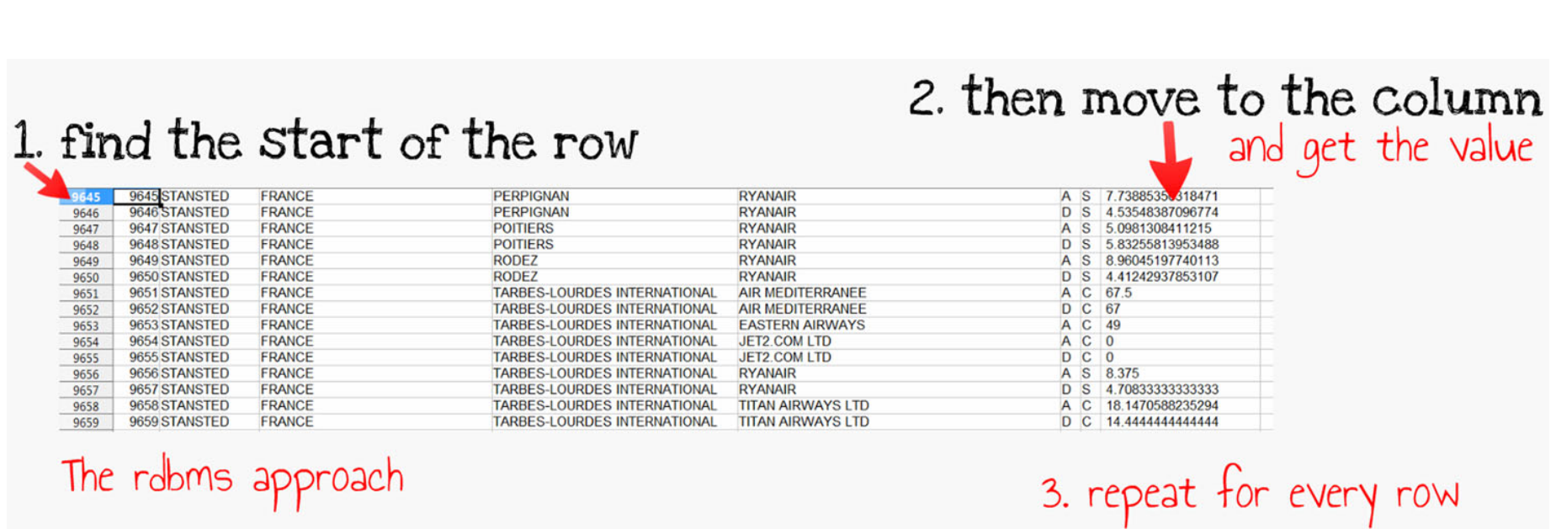
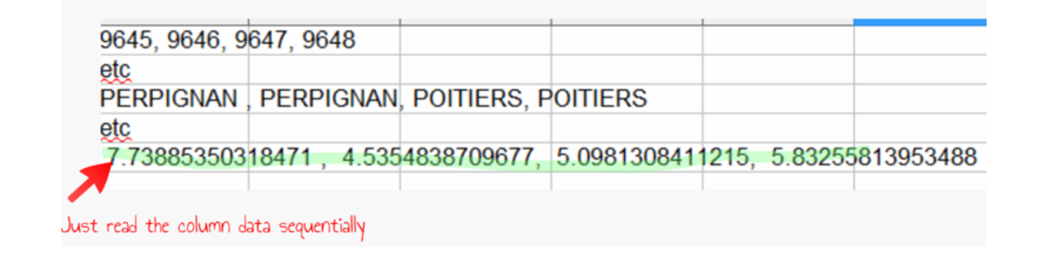
Abordări bazate pe coloane

Slide 11
Cassandra
Column Family
= colecție de coloane ce sunt accesate împreună de cele mai multe ori
Corespondentul tabelului din modelul relațional
Stocat într-un fișier distinct și sortat după valoarea cheii
Column
Unitatea de stocare
Are un nume unic, o valoare și un timestamp
Timestamp
Pentru rezolvarea de conflicte. E furnizat de client
Reprezintă numărul de milisecunde scurs de la 1 Ianuarie 1970
SuperColumn
Listă de coloane (asemănător unui view)
Notes:
A Column Family is roughly equivalent to a table in a RDBMS. Each such Family is stored in a separate physical file which is sorted into key order. To help reduce disk reads, and therefore improving performance, columns which are regularly accessed together should be kept together, within the same column family. A Column is the smallest unit of storage in Cassandra. A standard column is composed of a unique name (key),value and a timestamp. The key identifies a row in a Column Family. The timestamp is used to ensure distributed conflict resolution. It is usually defined as the difference between the current time and 00:00:00 UTC on 1 January 1970, also known as Unix epoch. The level of granularity is usually in milliseconds, or microseconds. The timestamp is provided by the client. This can be a problem in cases where the data is volatile and the accuracy of the client timestamp is uncertain. An external time server service can be a solution to this, but it does have performance implications. A SuperColumn is a list of columns. Although we have to remember that Cassandra is schema-less, you can think of this as a pot into which to put a variety of columns, rather like a view in a RDBMS. It is a mechanism for containing multiple columns with common look-up values. Again, thinking in relational terms, you might have a transaction with several attributes (Price, date, salesperson, for example). You could have a SuperColumn called TransationID which contains those attributes, each stored as columns.

Slide 12

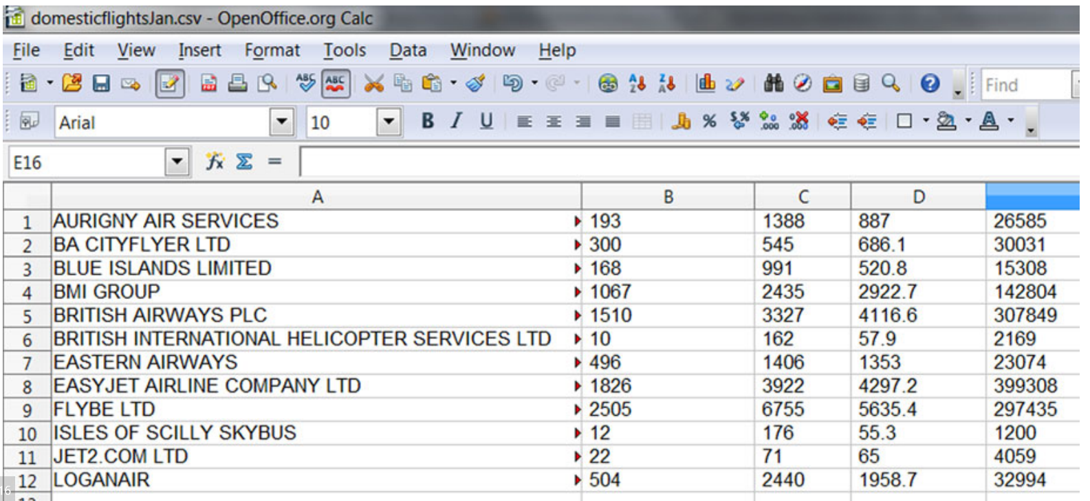
Exemplu de Column Family
Colecție de linii aeriene din Marea Britanie.
Coloane: Airline Name, Km Flown (x1000), No of Flights, No of Hours flown, Number of Passengers handled
Notes:
A Column Family is roughly equivalent to a table in a RDBMS. Each such Family is stored in a separate physical file which is sorted into key order. To help reduce disk reads, and therefore improving performance, columns which are regularly accessed together should be kept together, within the same column family. A Column is the smallest unit of storage in Cassandra. A standard column is composed of a unique name (key),value and a timestamp. The key identifies a row in a Column Family. The timestamp is used to ensure distributed conflict resolution. It is usually defined as the difference between the current time and 00:00:00 UTC on 1 January 1970, also known as Unix epoch. The level of granularity is usually in milliseconds, or microseconds. The timestamp is provided by the client. This can be a problem in cases where the data is volatile and the accuracy of the client timestamp is uncertain. An external time server service can be a solution to this, but it does have performance implications. A SuperColumn is a list of columns. Although we have to remember that Cassandra is schema-less, you can think of this as a pot into which to put a variety of columns, rather like a view in a RDBMS. It is a mechanism for containing multiple columns with common look-up values. Again, thinking in relational terms, you might have a transaction with several attributes (Price, date, salesperson, for example). You could have a SuperColumn called TransationID which contains those attributes, each stored as columns.

Slide 13
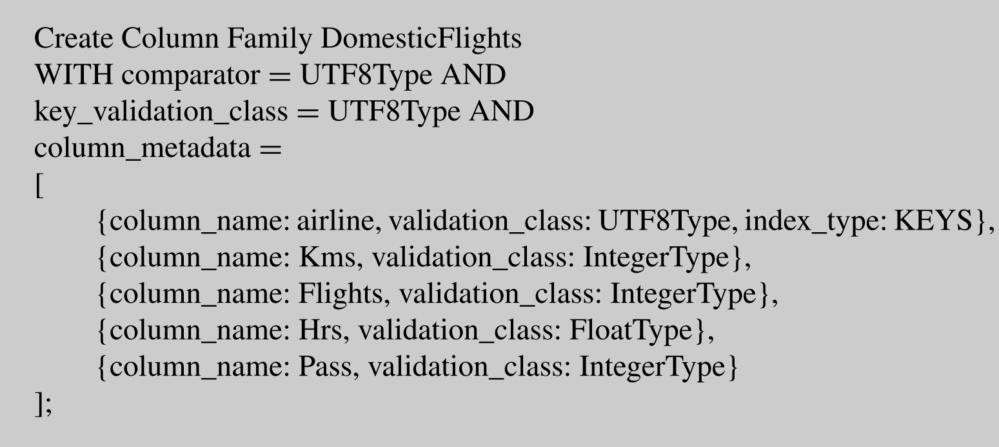
Crearea unui Column Family
Notes:
The comparator is required by Cassandra because it is needs to know the order in which to store columns.
Key_validation_class tells Cassandra what datatype the key is going to be. We will be using Airline so we have chosen UTF8, which is a string of characters and may have been described as a varchar in a RDBMS.
The validation class is similar to the definition of a datatype in a relational
database schema and provides, as its name suggests, the opportunity to validate data on input, only allowing data of the appropriate datatype to be written.

Slide 14
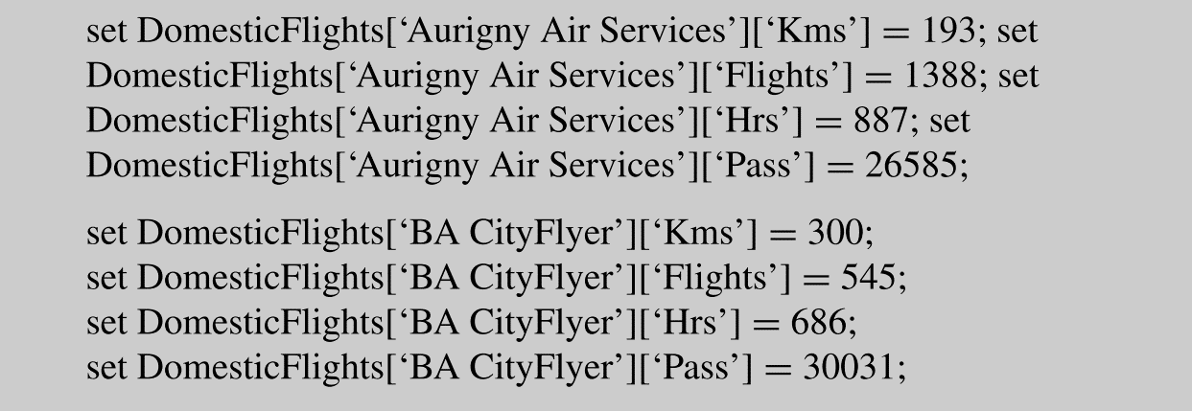
Inserare date

Slide 15
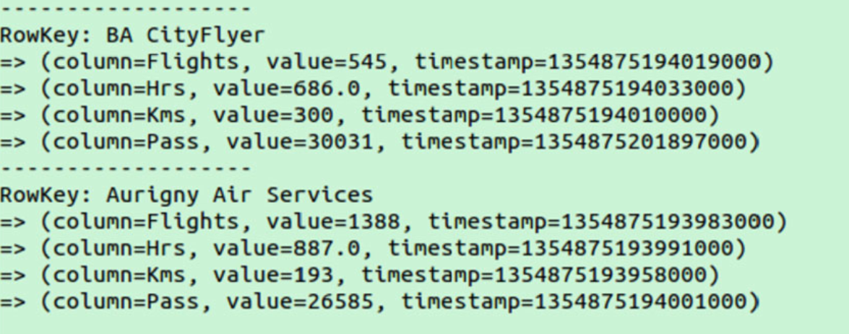
Regăsirea datelor
LIST DomesticFlights

Slide 16
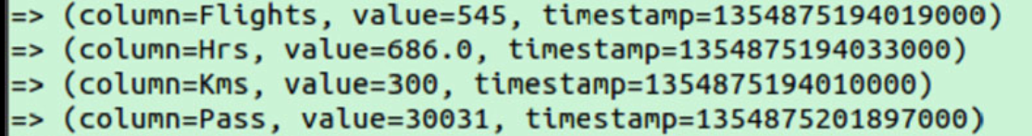
Regăsirea datelor
GET DomesticFlights[‘BA CityFlyer’]

Slide 17
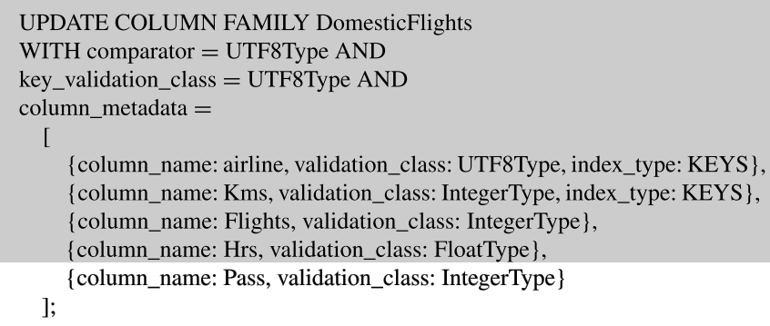
Modificare Column Family

Slide 18
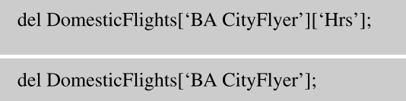

Ștergere date Ștergere Column Family

Slide 19
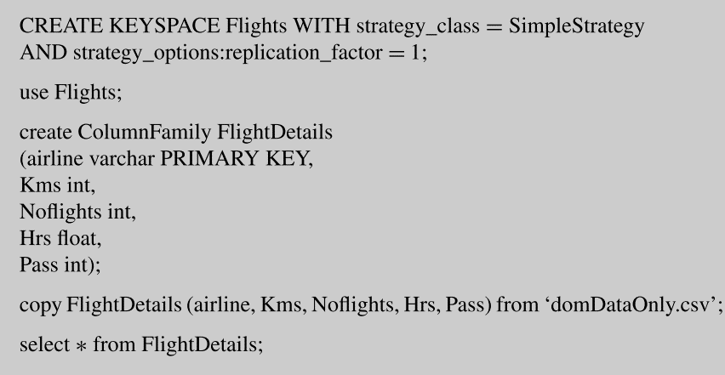
CQL Crearea unui Column Family
Notes:
The comparator is required by Cassandra because it is needs to know the order in which to store columns.
Key_validation_class tells Cassandra what datatype the key is going to be. We will be using Airline so we have chosen UTF8, which is a string of characters and may have been described as a varchar in a RDBMS.
The validation class is similar to the definition of a datatype in a relational
database schema and provides, as its name suggests, the opportunity to validate data on input, only allowing data of the appropriate datatype to be written.

Slide 20

CQL Regăsirea datelor
Notes:
The comparator is required by Cassandra because it is needs to know the order in which to store columns.
Key_validation_class tells Cassandra what datatype the key is going to be. We will be using Airline so we have chosen UTF8, which is a string of characters and may have been described as a varchar in a RDBMS.
The validation class is similar to the definition of a datatype in a relational
database schema and provides, as its name suggests, the opportunity to validate data on input, only allowing data of the appropriate datatype to be written.

Slide 21
Abordări bazate pe documente
nu există un design al bazei de date în adevăratul sens al cuvântului
bazele de date nu au o structură și nici constrângeri de integritate. (nici măcar de tip)
sharding - partiționarea unei baze de date foarte mari în părți de dimensiuni reduse și care sunt mai ușor și mai rapid de gestionat. Fiecare shard e memorat pe un nod ce are propria sa instanță activă de bază de date
MongoDB, CouchDB

Slide 22
MongoDB
Database – colecție de date înrudite
Collection – container pentru documente
Document – o componentă a colecției
Field – similar cu modelul relațional
Embedded document – cel mai potrivit corespondent din modelul relațional este join-ul
Primary key
Secondary key
Notes:
A Mongo Database is a collection of related data, just as in an RDBMS • A Mongo Collection is a container for documents. It can be thought of as RDBMS table-like
• A Mongo Document is rather like a RDBS Row • A Mongo Field is rather like a RDBS Column • A Mongo embedded document is rather like a RDBMS Join • A Mongo Primary key is the same as a RDBMS Primary Key • A Mongo Secondary index is the same as a RDBMS Secondary Index

Slide 23
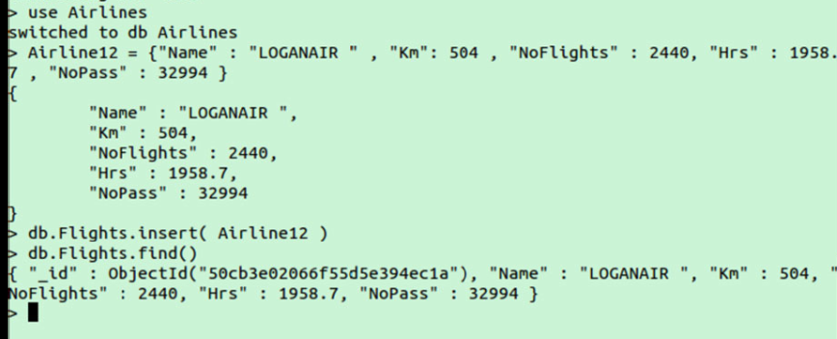
Adăugare date
Notes:
As we are working in a JavaScript environment we can create variables in memory which we pass to Mongo as parameters when we want to create documents. In the screenshot (Fig. 5.17) you will see we have:
1. Created a database called Airlines 2. Created a Javascript variable called Airline12 to store information about Loganair.
3. Checked the feedback screen to make sure the variable is correct 4. Used the insert() method of db to add the document to the collection 5. Checked that the data is saved by calling the find() method with no parameters to list all the collection contents
Note the lack of positive feedback from the system after the insert. And the fact
that MongoDB has created its own ObjectID to uniquely identify the document.

Slide 24
Regăsire date

Slide 25
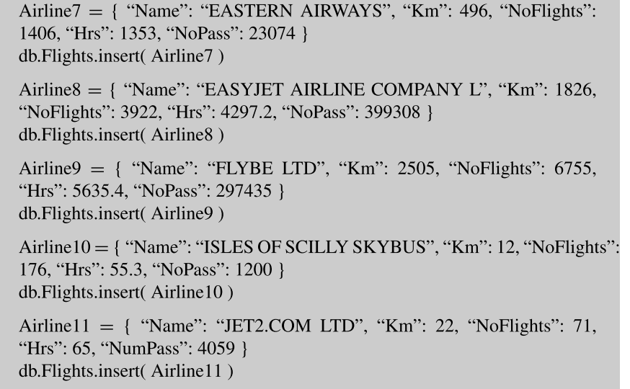
Regăsire date

Slide 26
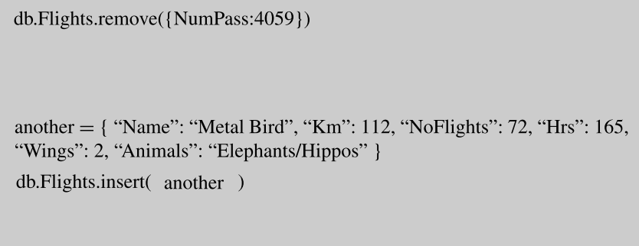
Regăsire date

Slide 27


Regăsire date
Notes:
We can perform some aggregation on the data we now have in the database using
some of the methods provided. The first thing we might like to do is count the number of documents we have
stored, which we call the count() method to do:
Then we might want to count particular items. For example, how many of the
Airlines in the list fly more than 1000k Kms?
So we pass a parameter to the count method which Mongo has to evaluate. Note
the syntax, with the use of “{}” pairs to separate out the distinct elements of the expression. $gt means greater than. We saw earlier that.find() can be used to find specific values. These searches can
be ANDed, again with the use of “{}”. Have a look at the example below and see if you can work out what will be returned. Note the use of “[]” with the $and to pass an array of several expressions.

Slide 28
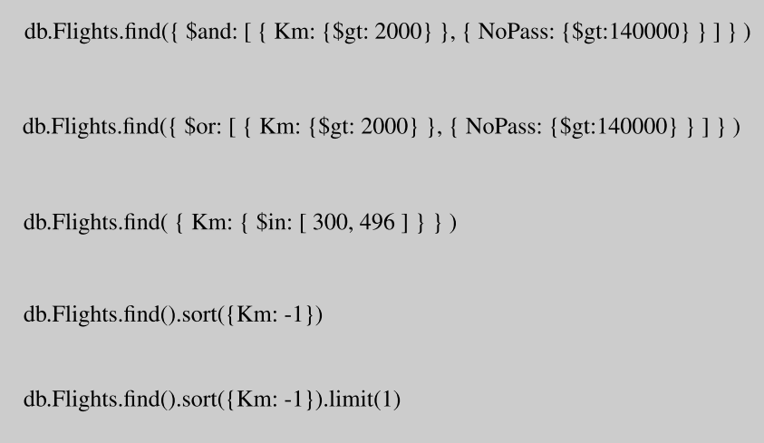

Regăsire date
Notes:
db.Flights.find({ $and: [ { Km: {$gt: 2000} }, { NoPass: {$gt:140000} } ] } )
There is also an $or operator that works in a similar way. Will the following
generate more or less rows?
db.Flights.find({ $or: [ { Km: {$gt: 2000} }, { NoPass: {$gt:140000} } ] } )
Looking for values from a list is also possible, using the $in operator. In this
example we look for two values of Km. db.Flights.find( { Km: { $in: [ 300, 496 ] } } ) If you want your output sorted you can use the $sort operator. It needs a sort type
to be passed of either −1 (descending) or 1 (ascending). db.Flights.find().sort({Km: -1}) A little confusingly you would need to use this sort to discover the Min and Max
values in a field since Mongo uses Min and Max in a very different way elsewhere. Here we answer the question Which Airline flew the most Kms?
db.Flights.find().sort({Km: -1}).limit(1) So we sort descending but limit printed output to one row, answering the question
in doing so.

Slide 29
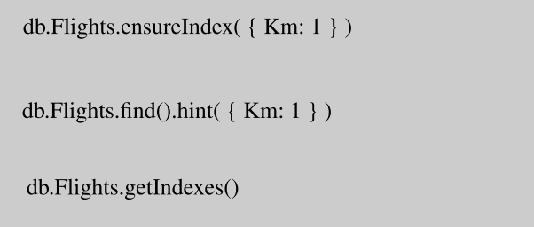
Indexare
structura indecșilor MongoDB este de B-arbore
Notes:
Lets assume we decide we will query the collection often using the Km in our
queries. To have secondary index on that field we would issue this command (the 1 indicating Ascending)
db.Flights.ensureIndex( { Km: 1 } ) Queries such as our earlier one to count documents where Km is above a level
would automatically use this index. You can also force the optimiser to use the index, as with the example below where we hint to use the index that has been created on the Km field. Note how the data output is sorted in Km order when you use the index.
db.Flights.find().hint( { Km: 1 } ) You can review the indexes available with the getIndexes method on the collection: db.Flights.getIndexes()

Slide 30
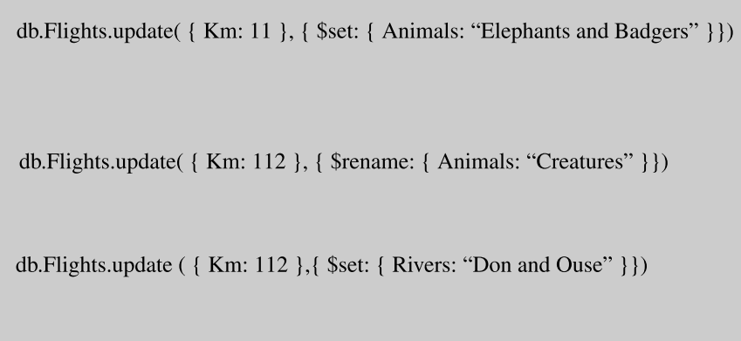
Actualizarea datelor
Notes:
Assuming we made a mistake with the entry in the Animals field, we could locate
the document using the unique identifier, or as a result of a query, and then pass the change as a parameter. Below, we find the first document for which the Km = 11, and then change the value in the Animals field “Elephants and Badgers”:
db.Flights.update( { Km: 11 }, { $set: { Animals: “Elephants and Badgers” }})
If we wanted to change the name of fields we could do this by replacing $set with
$rename, as below; db.Flights.update( { Km: 112 }, { $rename: { Animals: “Creatures” }}) Finally, we may want to add a field, with a value in it: db.Flights.update ( { Km: 112 },{ $set: { Rivers: “Don and Ouse” }}) In this case, because there is no field called “Rivers”, Mongo creates the field and
then adds the value “Don and Ouse”.

Slide 31


Slide 32
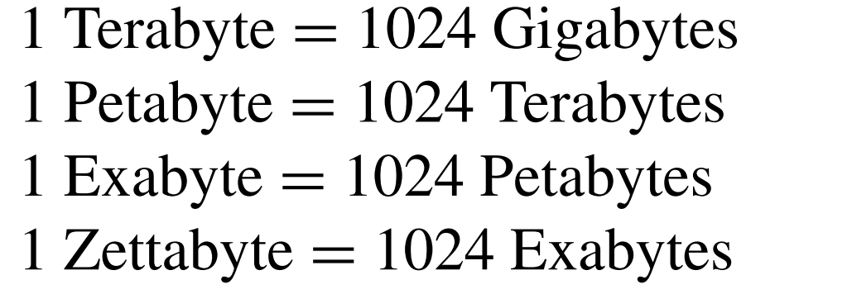
250 mlrd DVD-uri

Slide 33
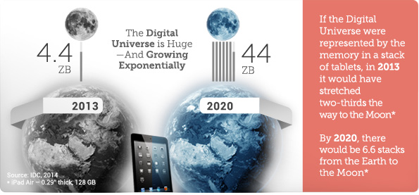

Slide 34
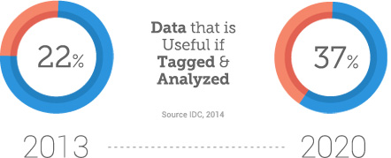
doar 0.5% din date
sunt analizate

Slide 35
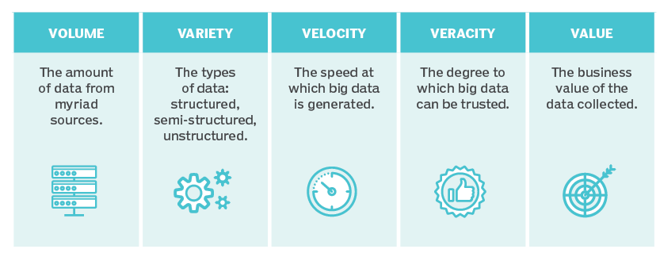
Cei cinci V ai Big Data
Sursa: https://cdn.ttgtmedia.com/rms/onlineimages/
Notes:
Data Scientist: The Sexiest Job of the 21st Century

Slide 36
Intrumente
Map Reduce
Hadoop
Hive
Pig
Notes:
Map Reduce
looking through all the data and extracting a key identifier and a value, and then storing that in a list.
• Then using grouping, reducing the data thus listed such that you can get information like group totals, averages, minimums and the like.

